Slide 1
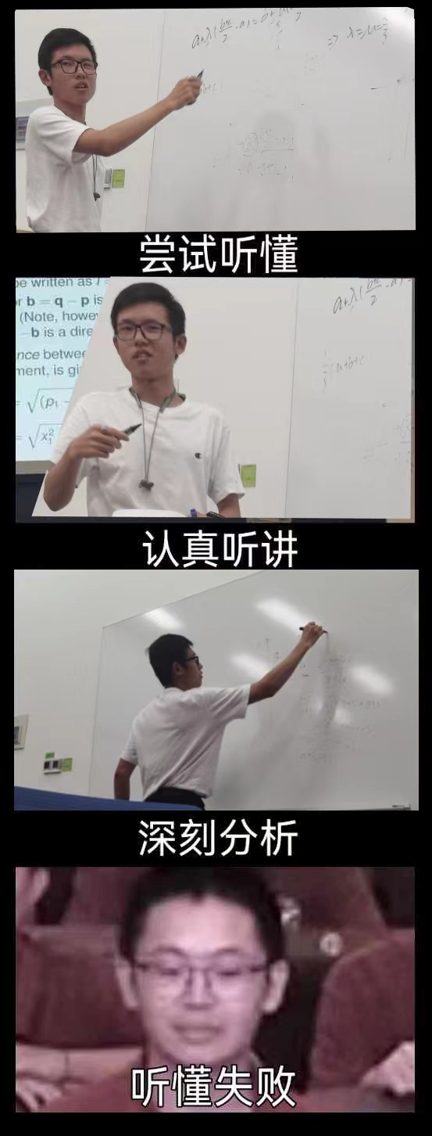
MATH 285 Week 4 DI 2

Slide 2




Uniform Convergence and Point-wise Convergence
Uniform Convergence Point-wise Convergence
https://www.bilibili.com/video/BV1hh41127Js

Slide 3


Slide 4


Slide 5
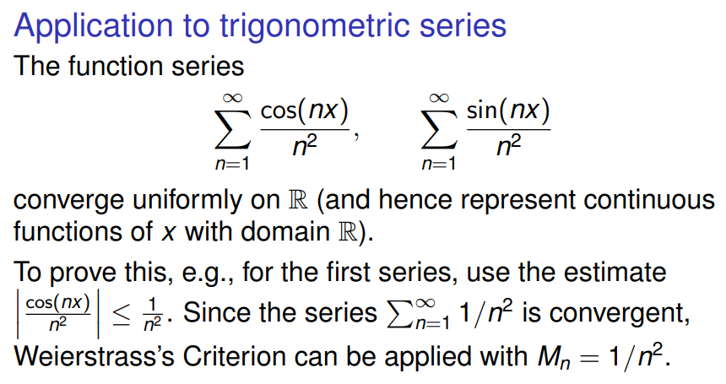

Slide 6


Slide 7


Slide 8


